Slide 1

Being a maker – now, more fun than ever…
Gil Tal
Mar 2025

Slide 2
Being a maker, what does it mean?
A maker is an electronic biased hobbyist
You need to have basic and up SW and HW capabilities
And foremost you need passion ☺
Makers these days have huge possibilities very easy to reach
Arduino for example is a very reachable and easy to use maker’s platform
Makers today can easily build robots, drones, arcade machines and much more…

Slide 3
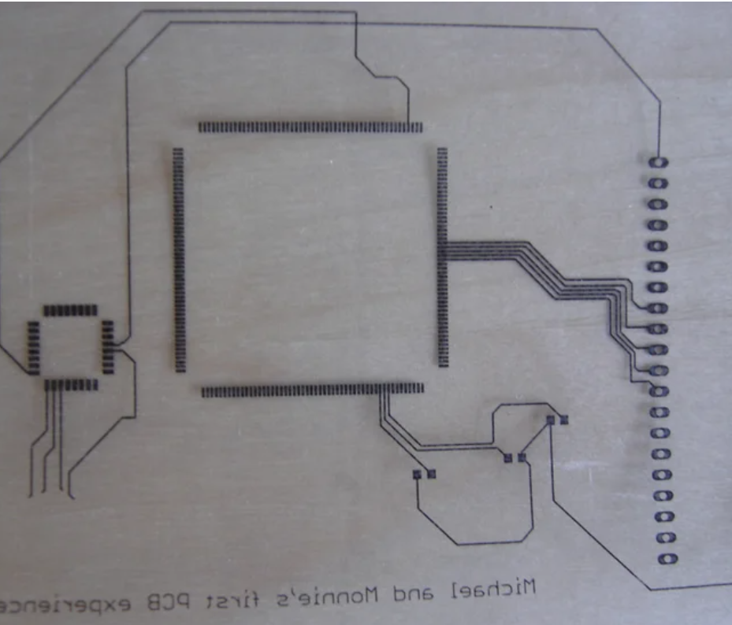
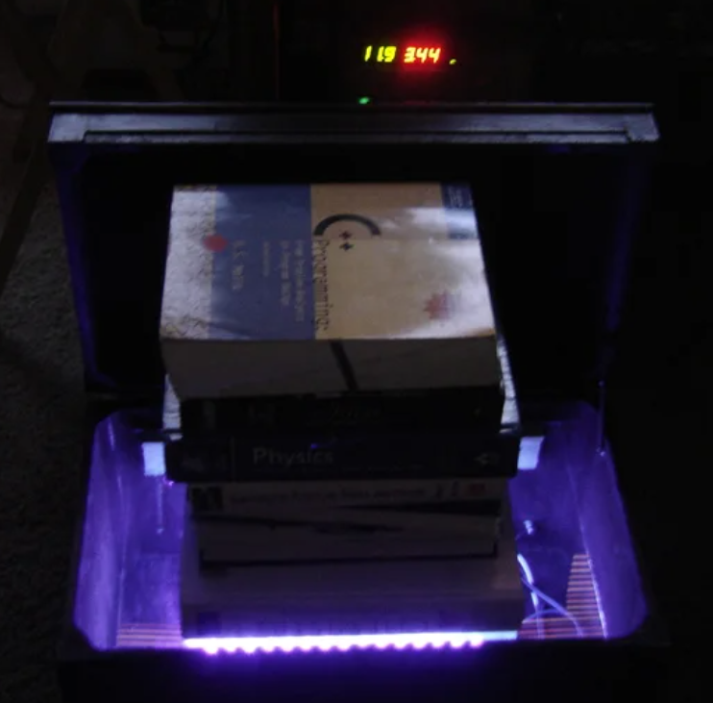
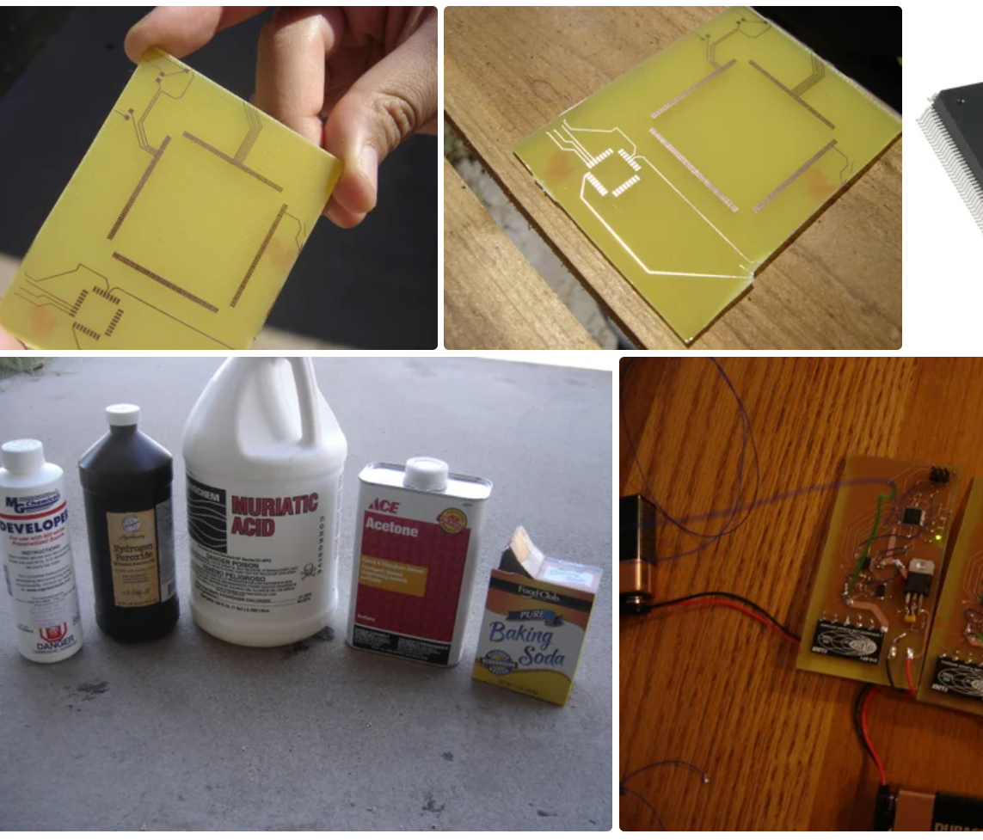
Many years ago ….

Slide 4
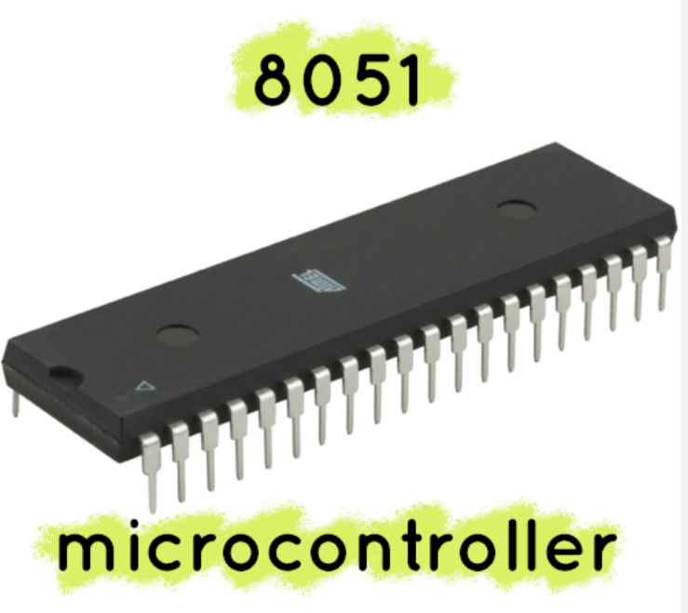
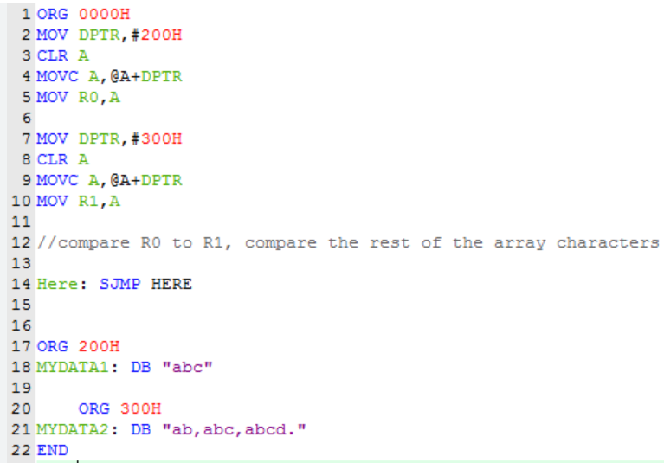
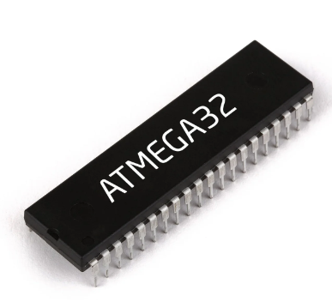
The first micro controllers …

Slide 5
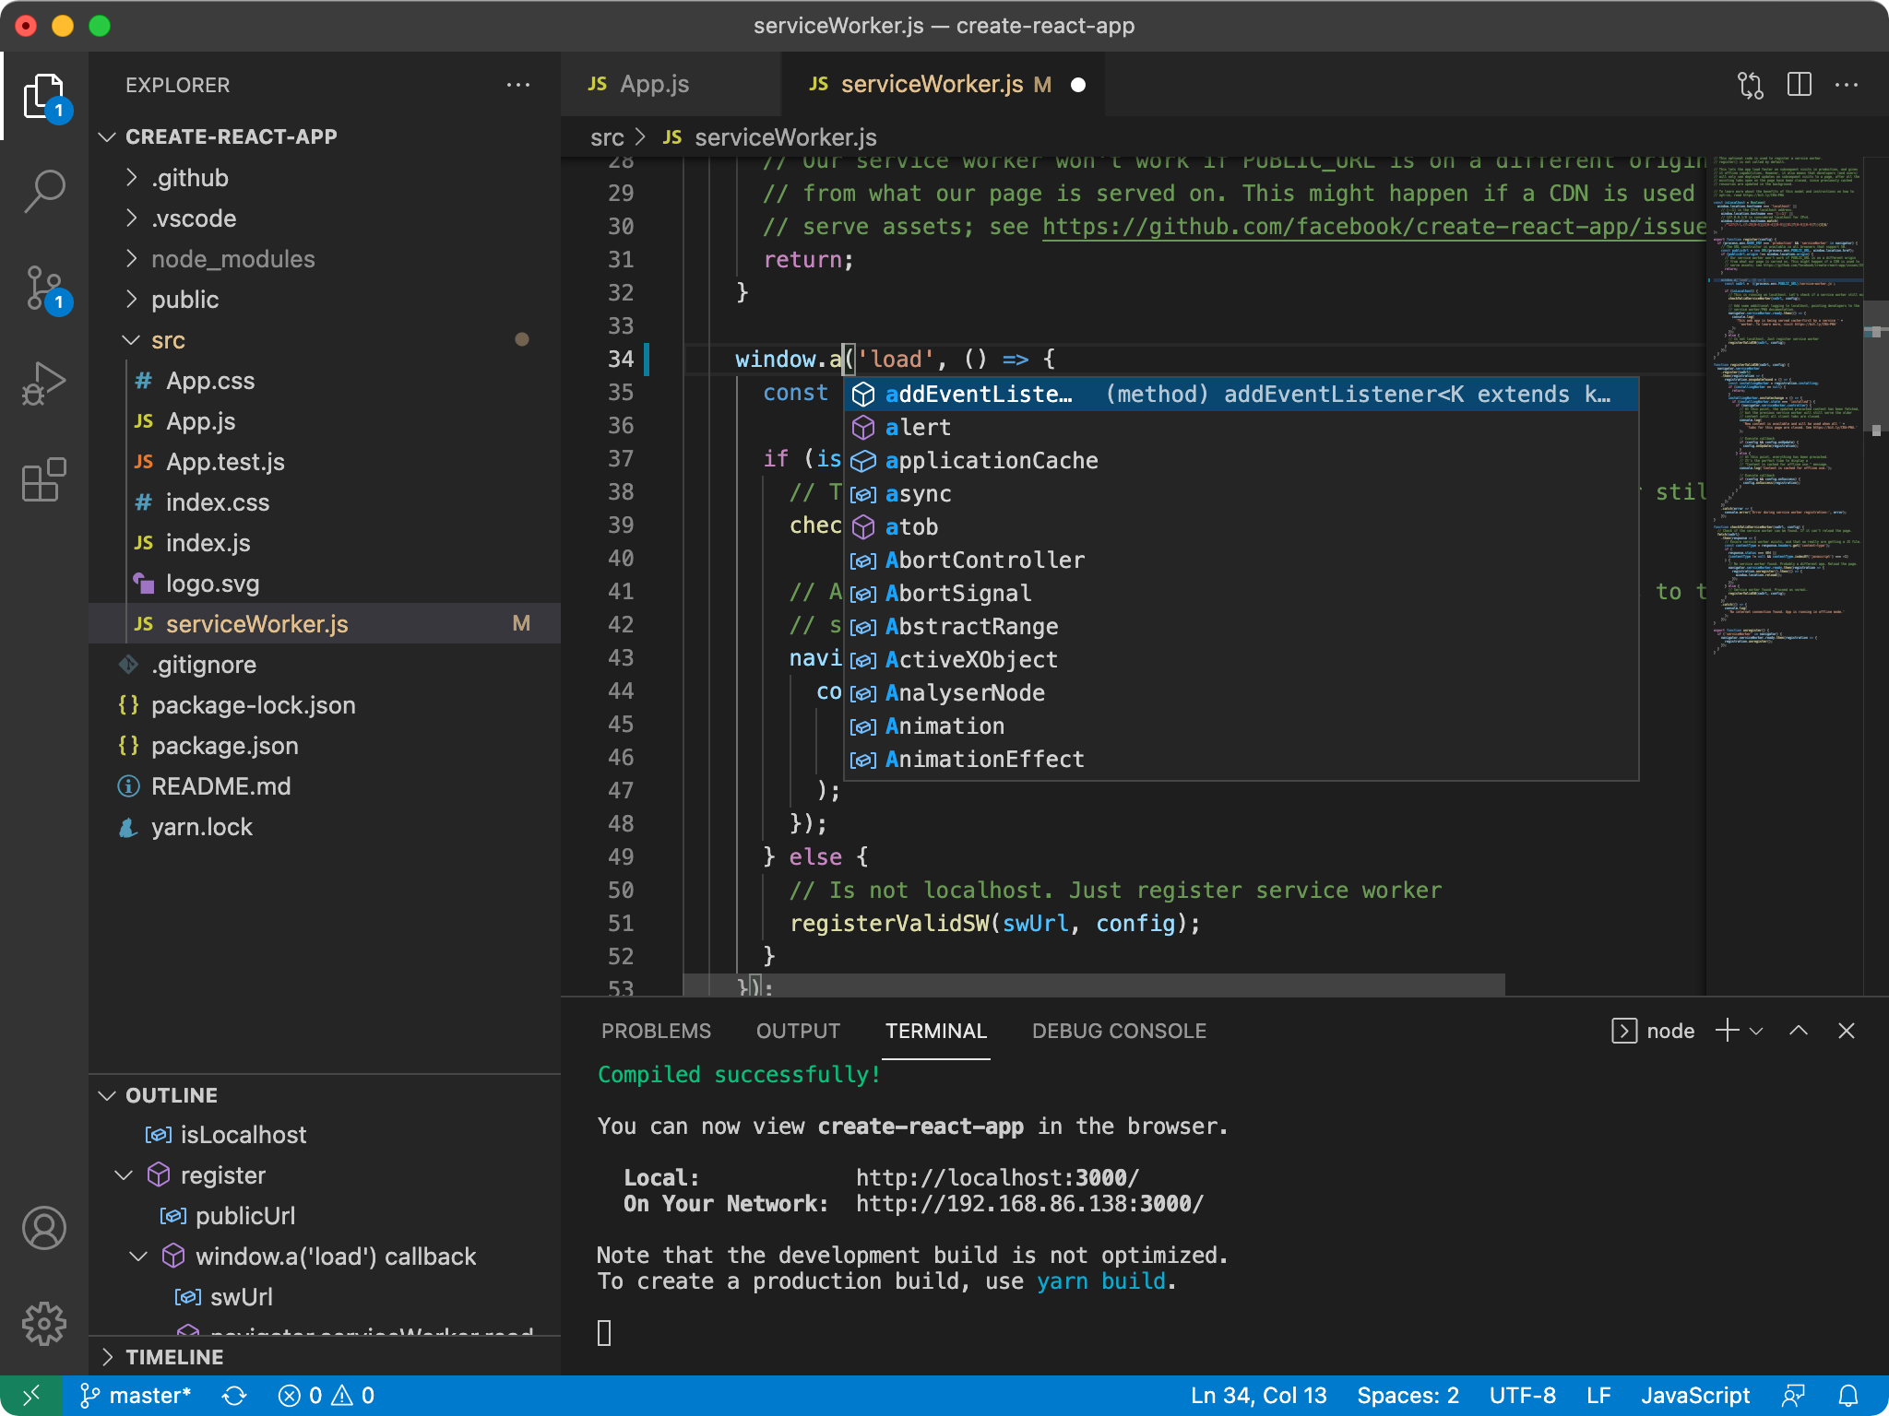
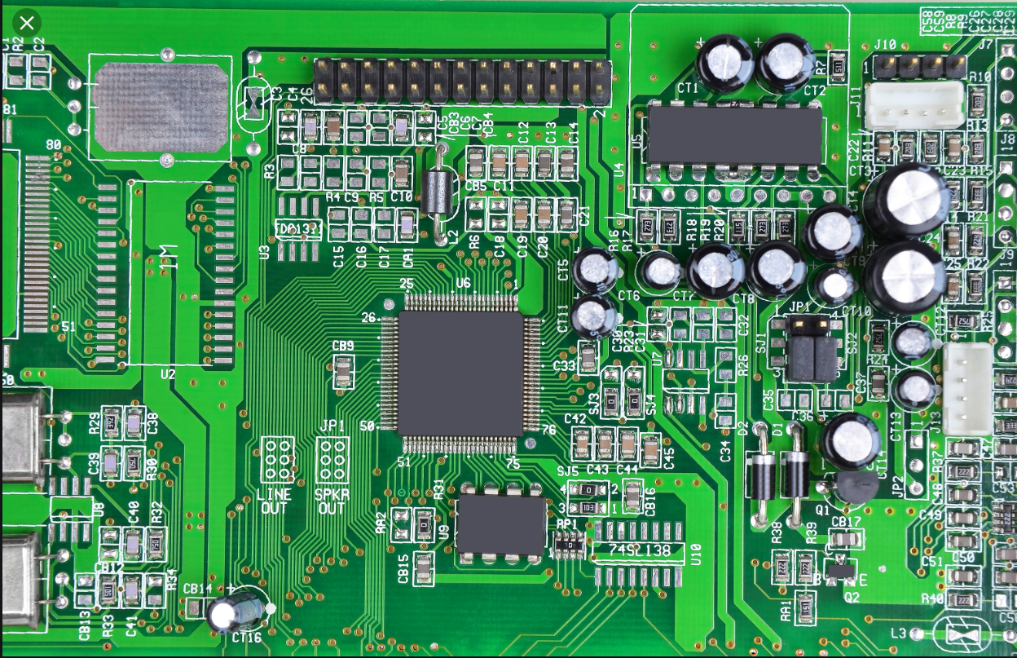
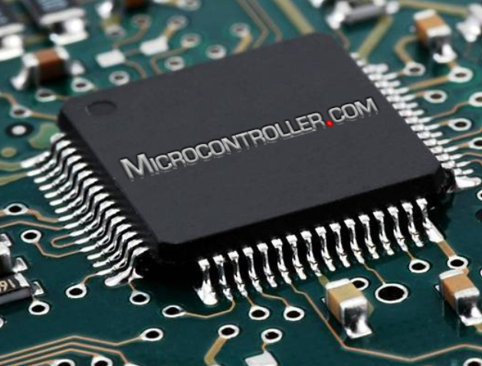

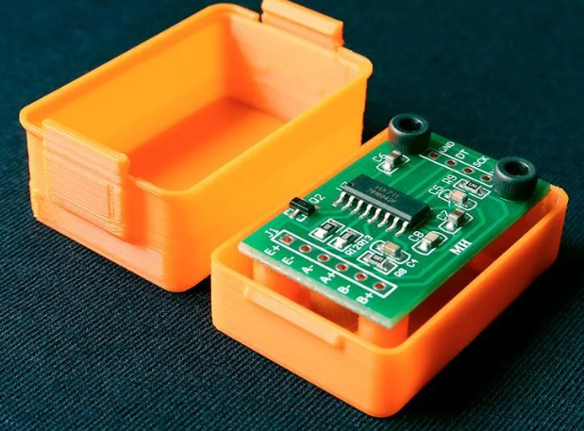
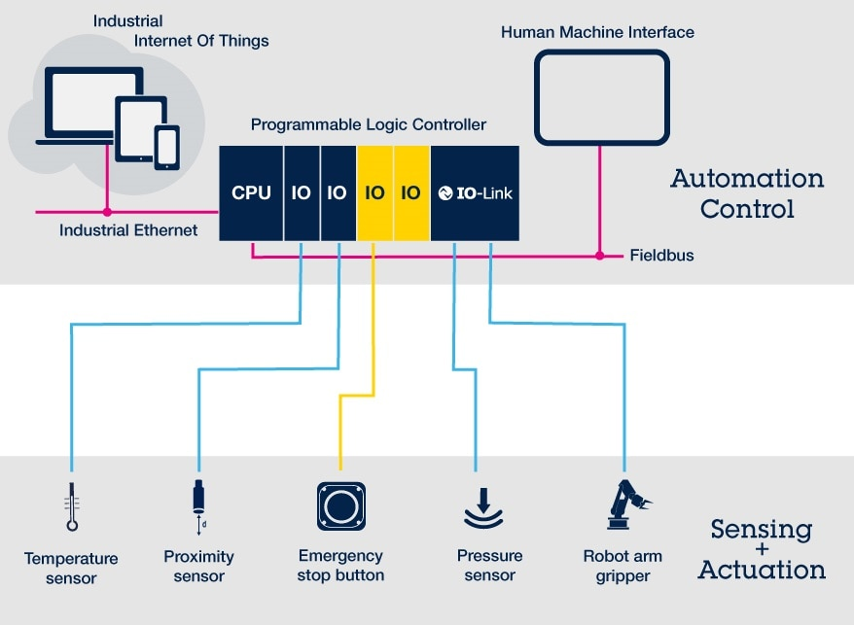
Building blocks for makers
IDE
PCB
Compute power
Communication
Enclosure \ Physical support
Control

Slide 6


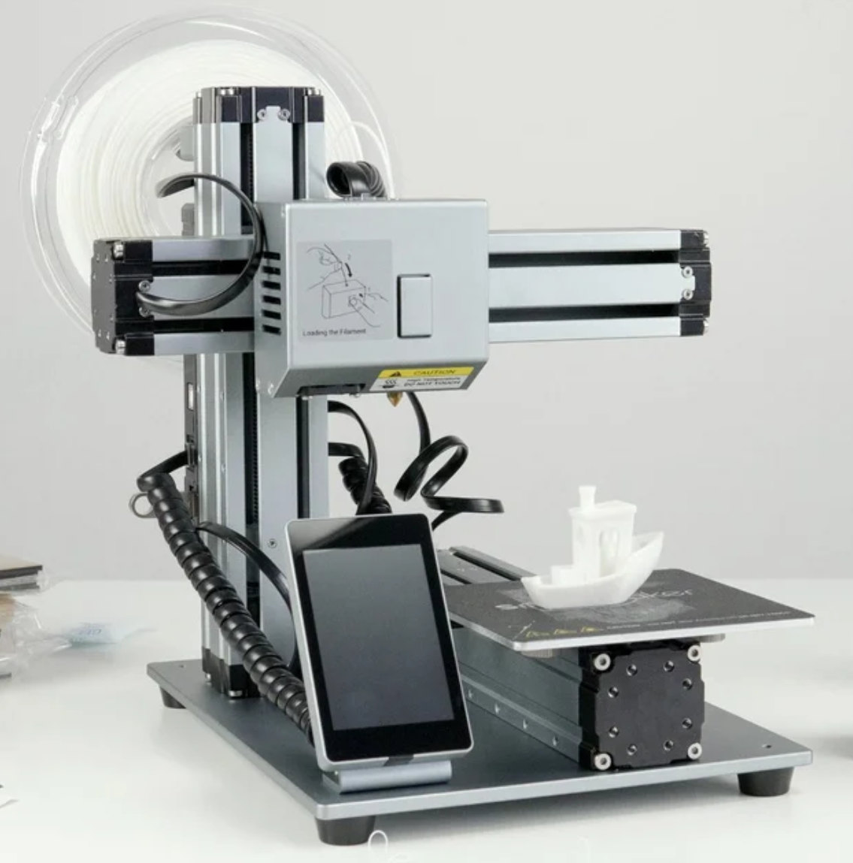
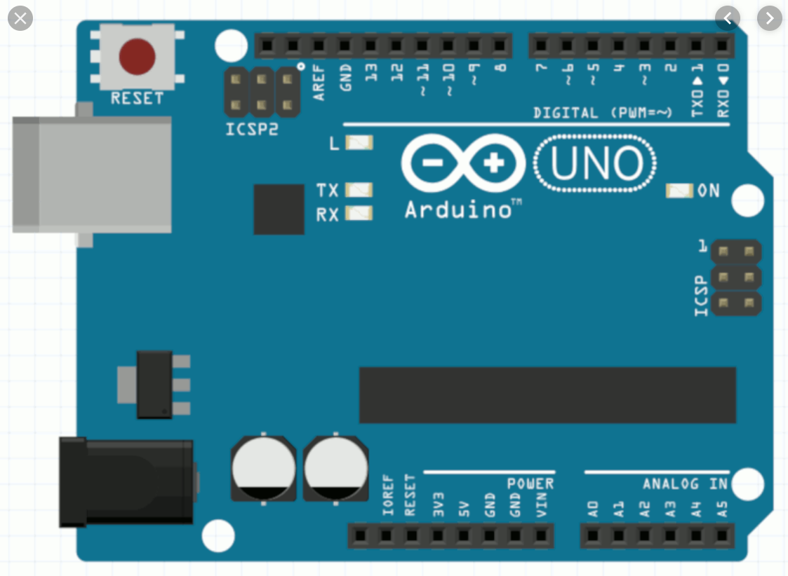
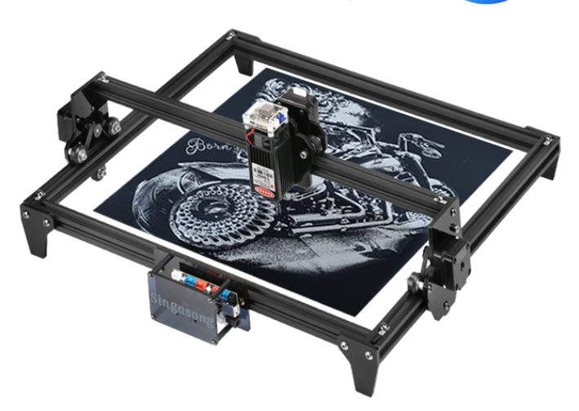
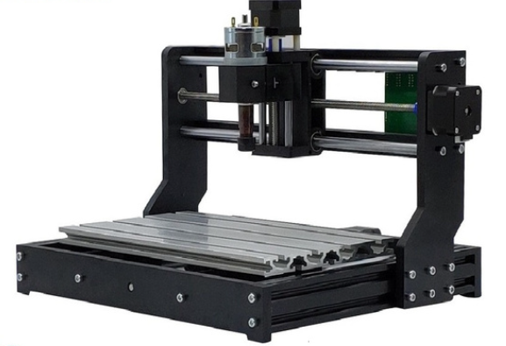
So, what have changed that makes it more fun and accessible than ever?

Slide 7
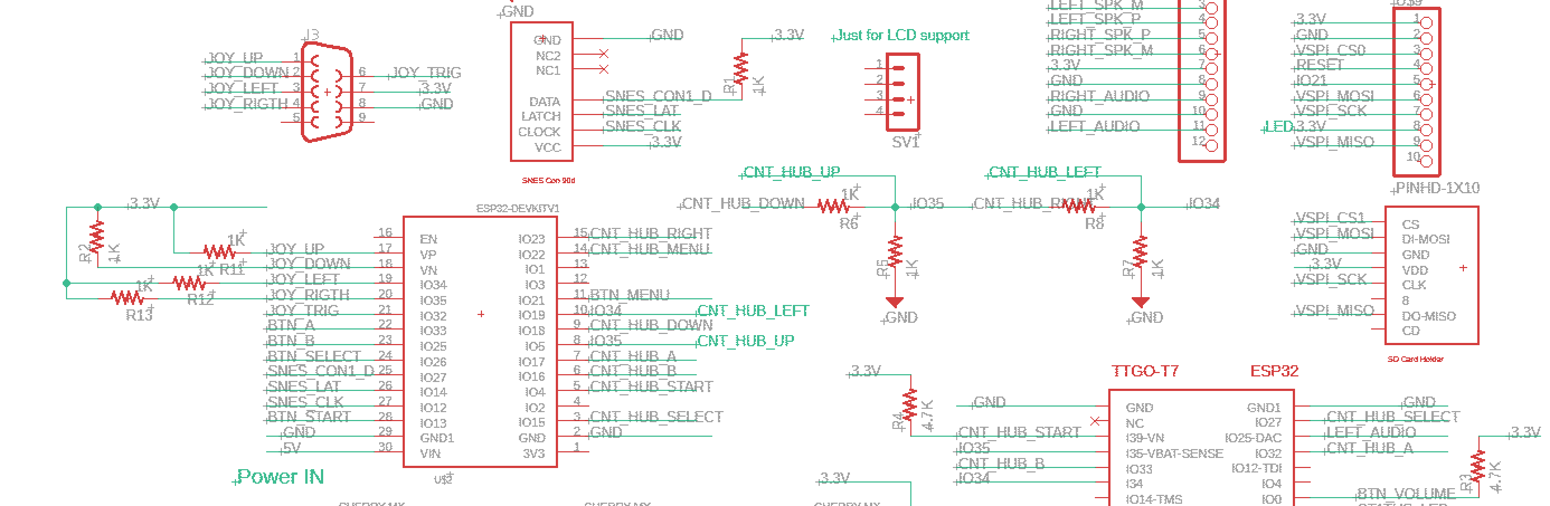
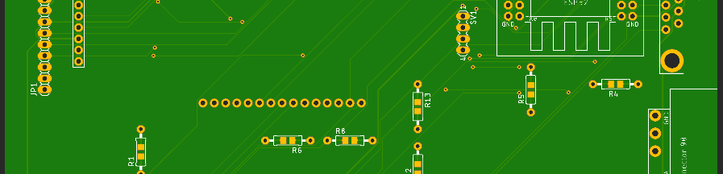
PCB production
Fusion 360 electronics (basic version is free) – all in one software, one click for production file
JLCpcb, PCBway – 2$ for 5 boards + shipment
~7 days to get the board

Slide 8
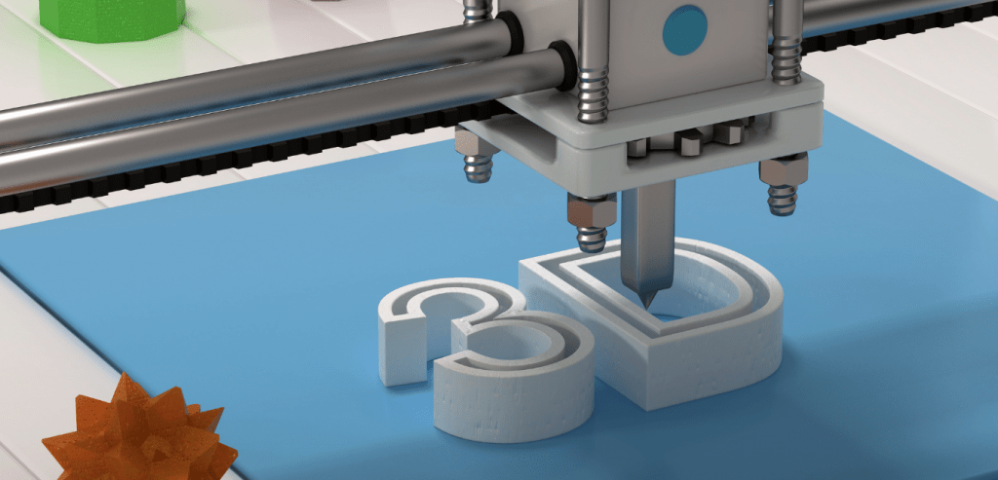
Fusion 360 (Tinker cad) is free for makers!
3D printers comes relatively cheap (~200$ and up)
1KG of PLA\Resin is around 15-25$
There are FDM printers and resin (liquid)
Resin can print amazingly detailed objects
For FDM there are some interesting materials

Slide 9
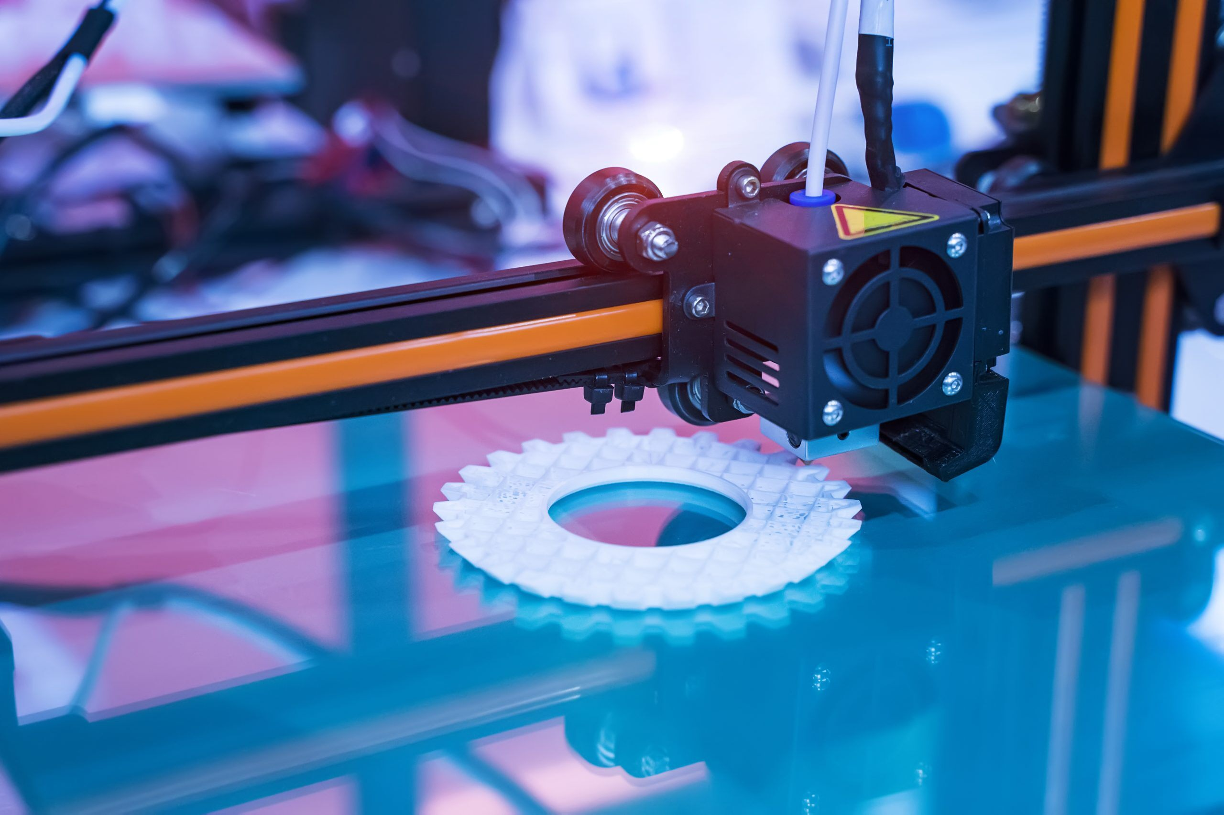
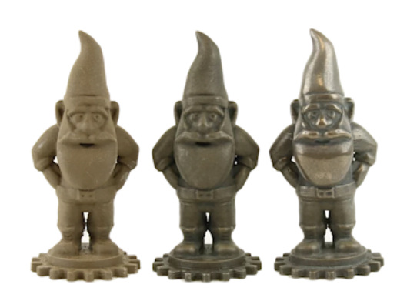
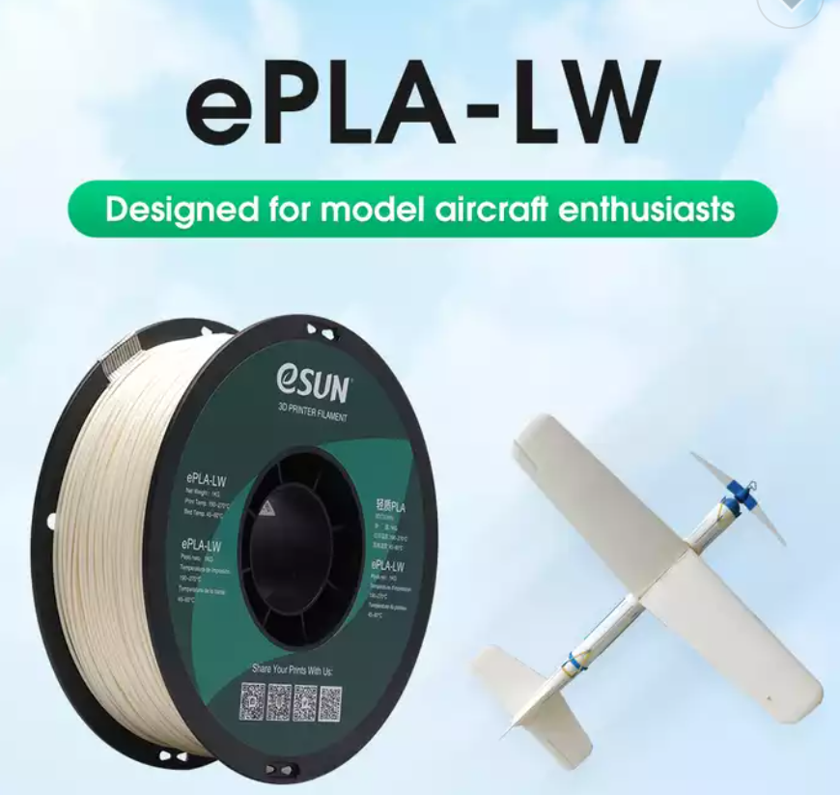
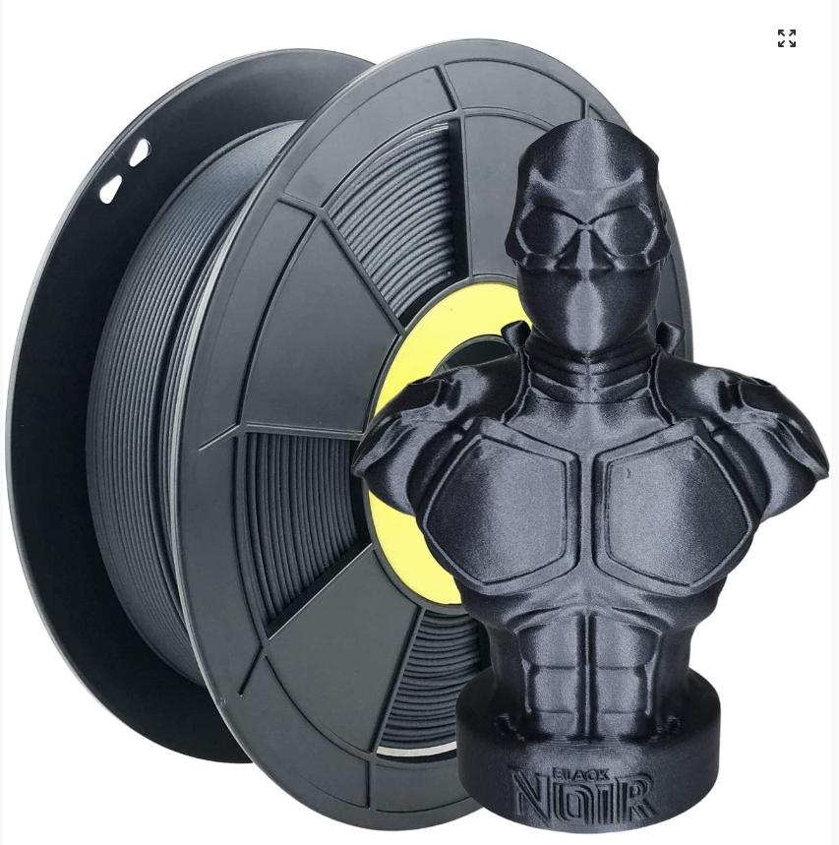
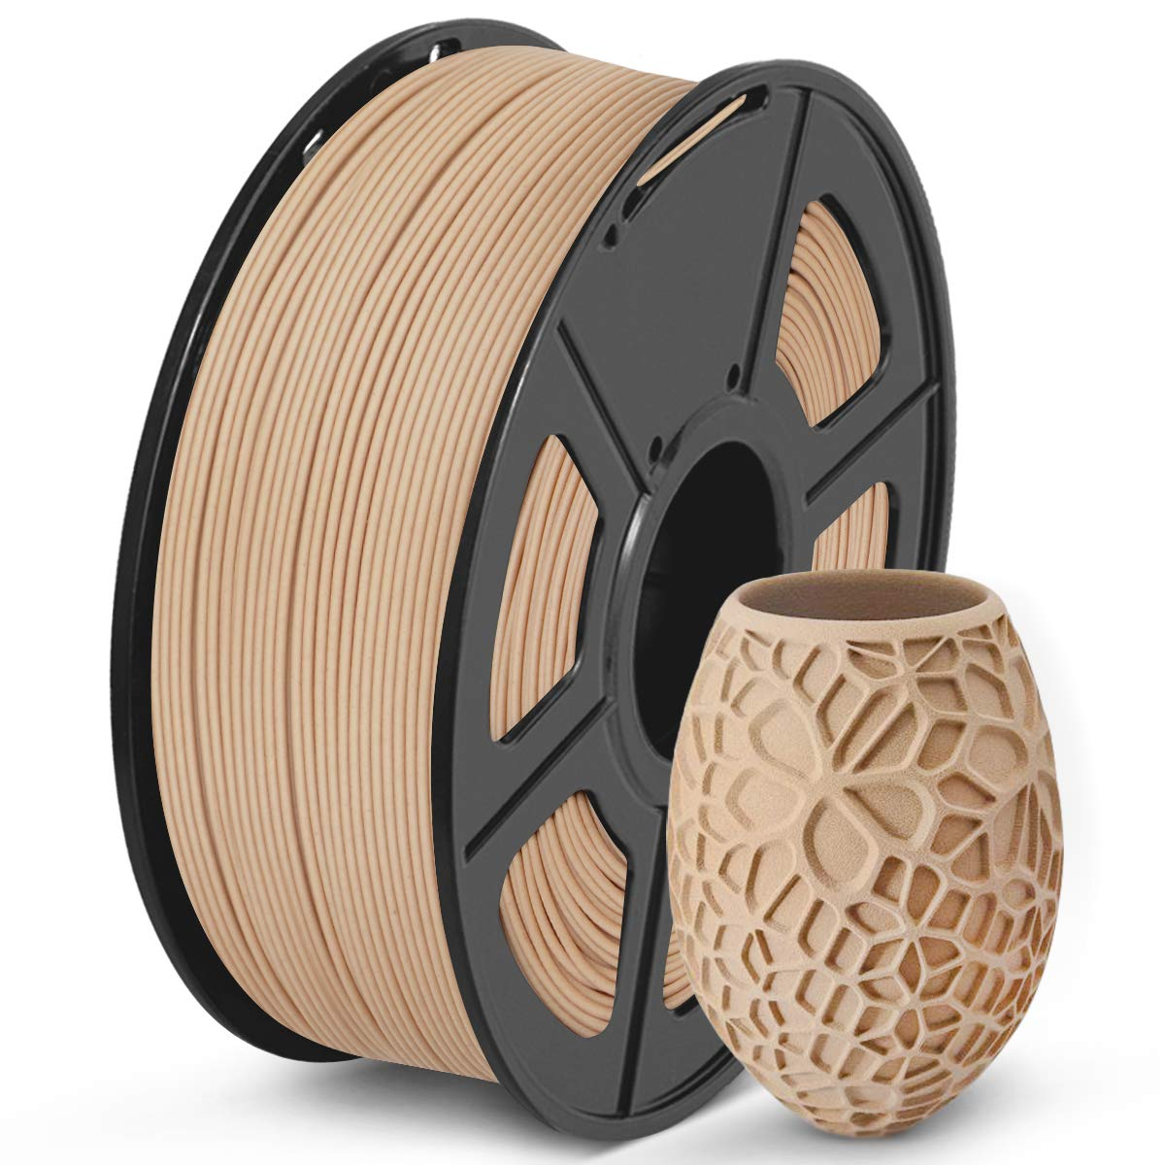

Slide 10
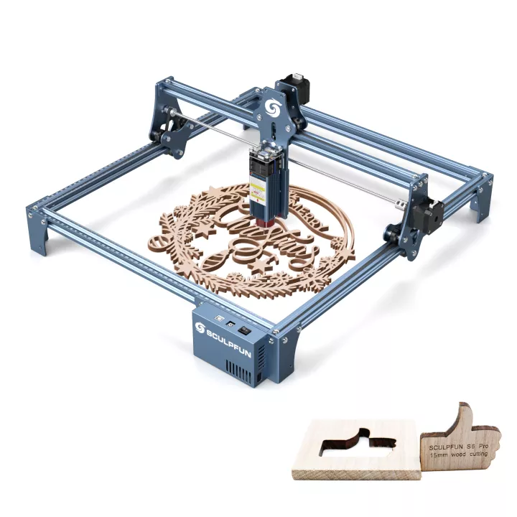
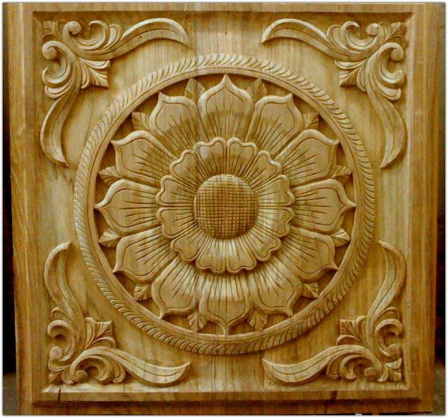
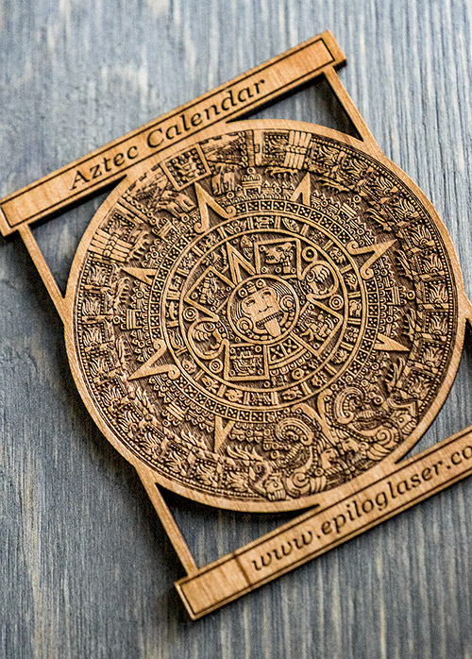

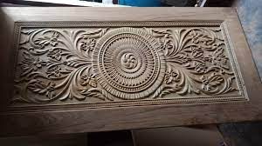
CNC and laser engraver \ cutter
Around 300$+
Amazing capabilities

Slide 11

The Arduino makers platform – how it all started…
The Arduino project was started at the Interaction Design Institute Ivrea (IDII) in Ivrea, Italy
In 2003 Hernando Barragán created the development platform Wiring as a Master's thesis project at IDII – Which was used as the basis for the Arduino platform
Under the supervision of Massimo Banzi and Casey Reas. Casey Reas is known for co-creating, with Ben Fry, the Processing development platform
The project goal was to create simple, low cost tools for creating digital projects by non-engineers!
The initial Arduino core team consisted of Massimo Banzi, David Cuartielles, Tom Igoe, Gianluca Martino, and David Mellis, but Barragán was not invited to participate
Millions of Arduino boards are in use around the world!

Slide 12
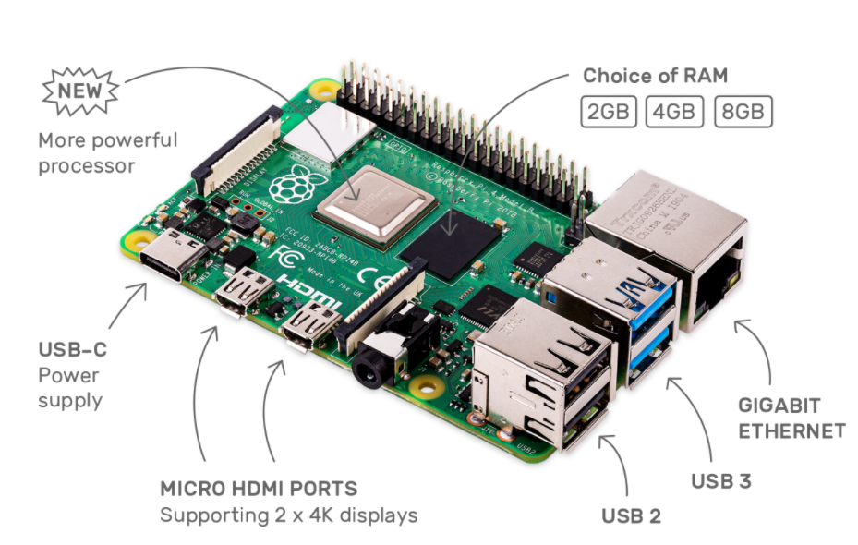

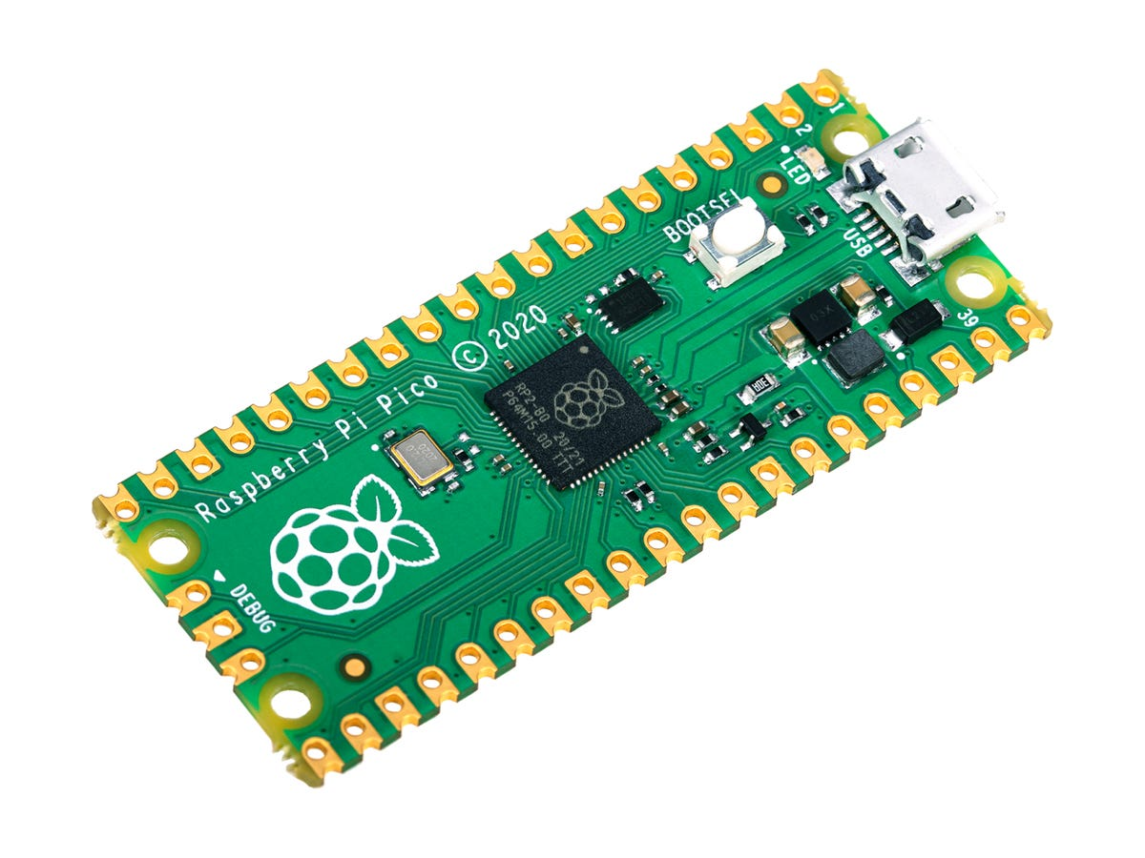
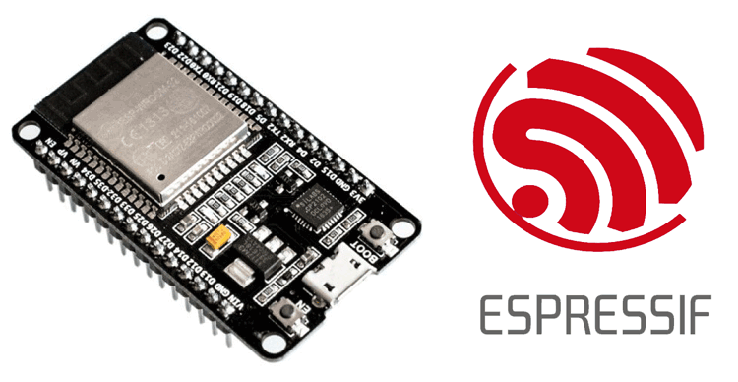
Arduino was just the beginning …
Raspberry PI 4/5
40-80$
Monster performance
Complex AI
Dual RISC-V @ 400 MHz
Up to 32 MB of SRAM
AI acceleration
CSI\DSI
~8$
Raspberry PI Pico
4-5$ (clones)
Dual CPU (ARM @ 133MHz)
256KB SRAM
2MB flash
ESP8266\ESP32\ESP32 S2\S3\C3\C6
2-5$
Great performance (Dual CPU @ 240MHz)
WiFi and Bluetooth
Camera\LCD
Arduino IDE!
FreeRTOS (Multi Tasking)
OTA
Complex projects
Up to 16MB of flash
Up to 8MB of SRAM!!
Arduino Uno\Due\Zero
2-5$ (clones)
Limited performance and features
Enough for lots of simple projects

Slide 13
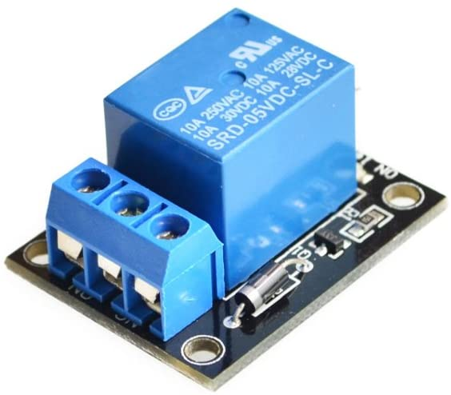
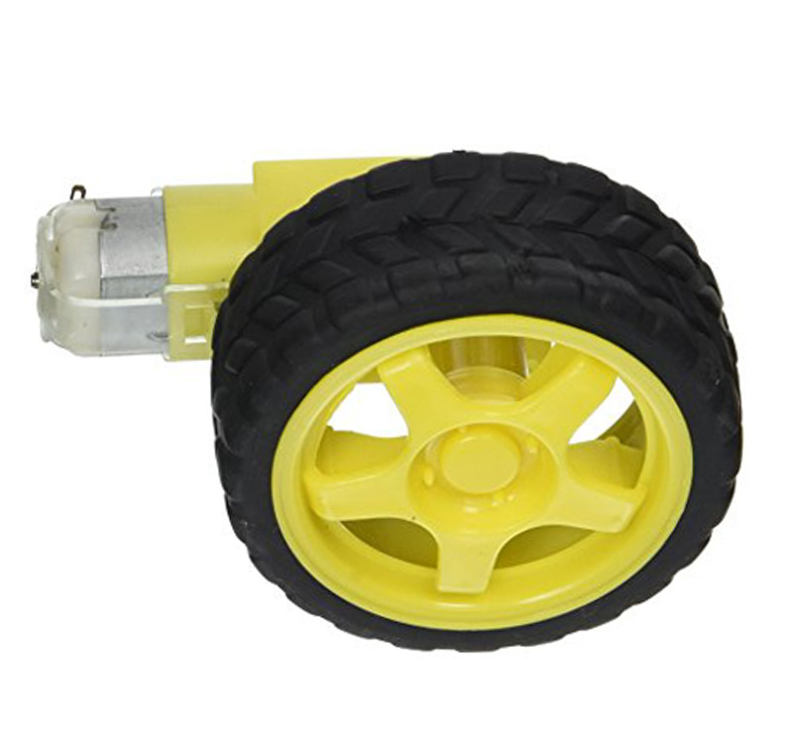
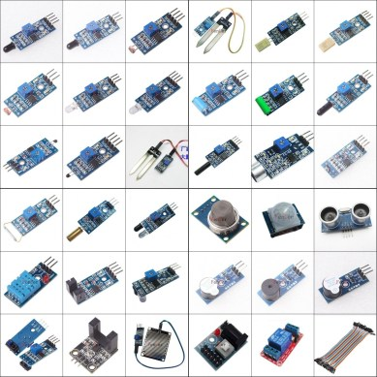
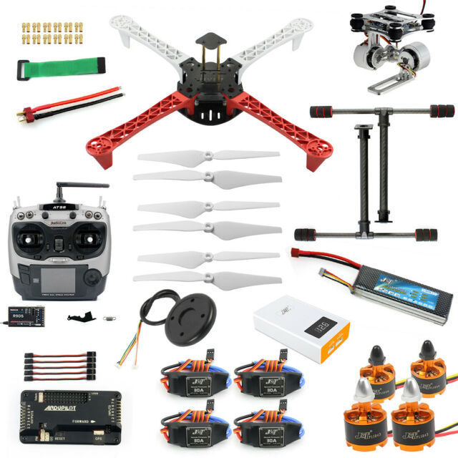

What is there for us to use:

Slide 14
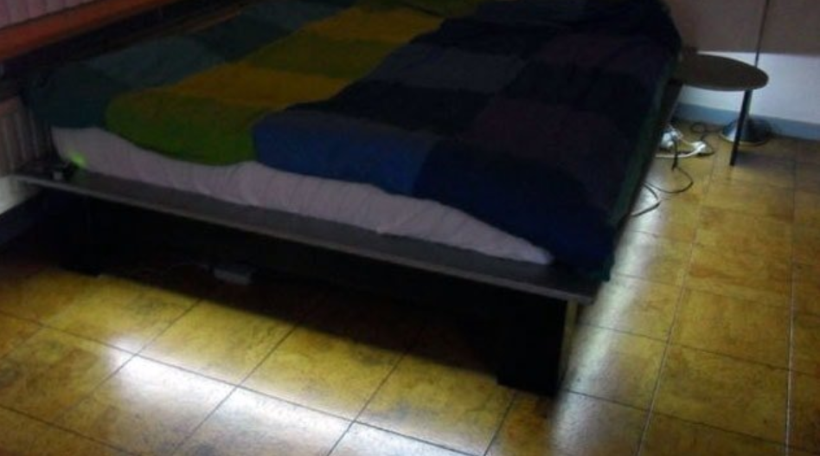
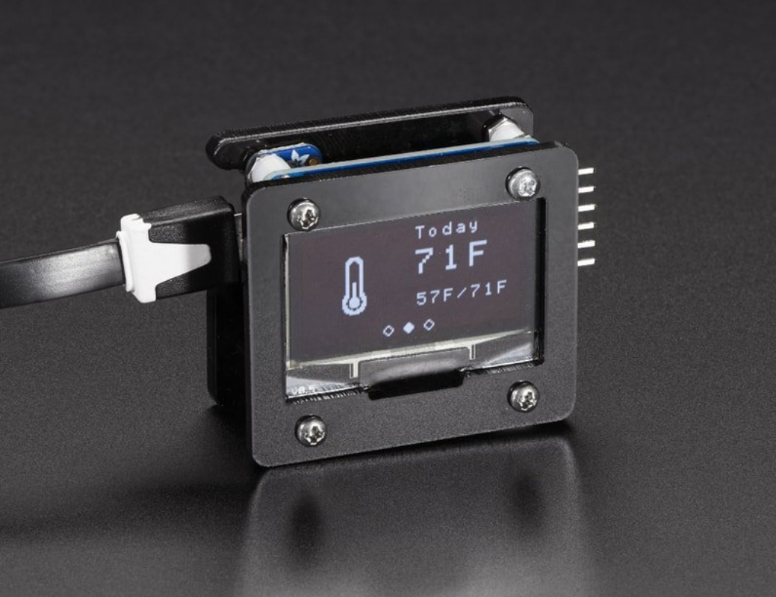
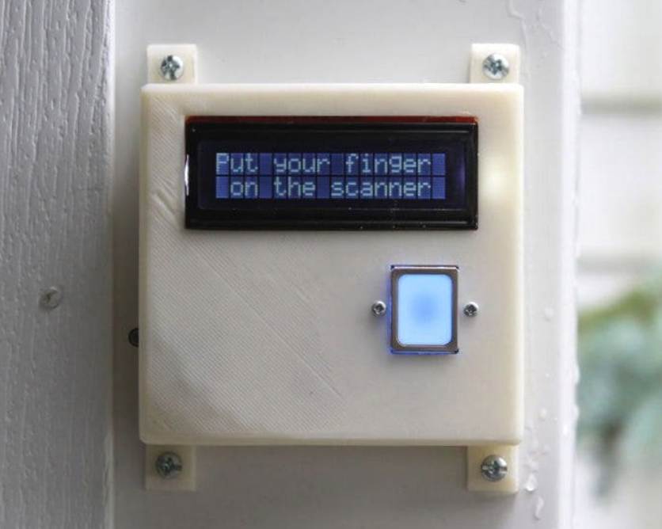
Some cool projects

Slide 15
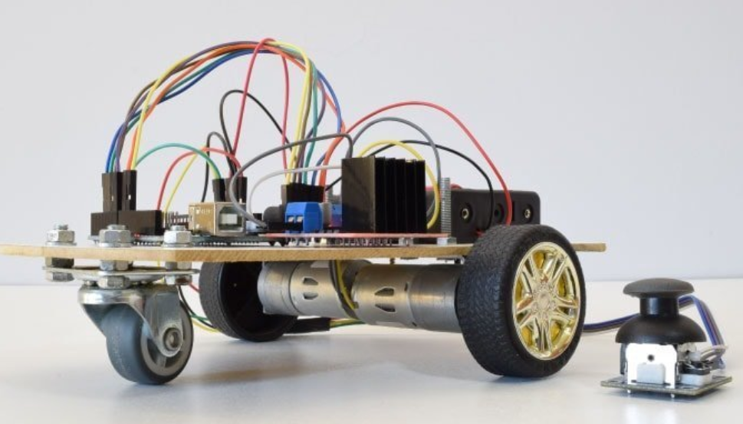
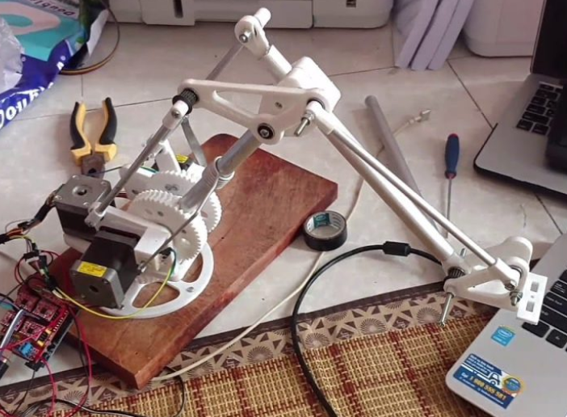
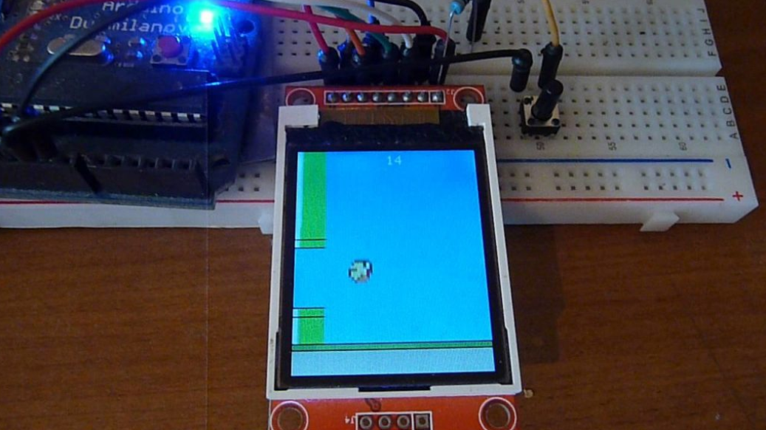
More…

Slide 16
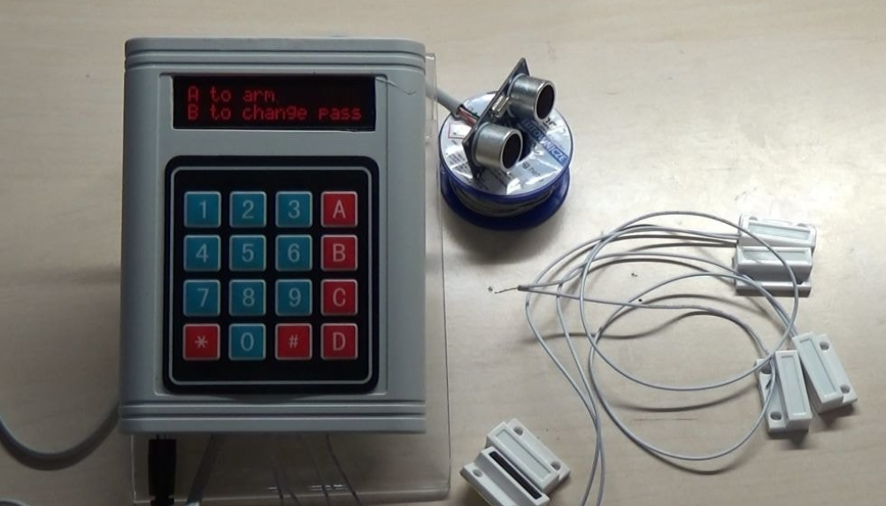
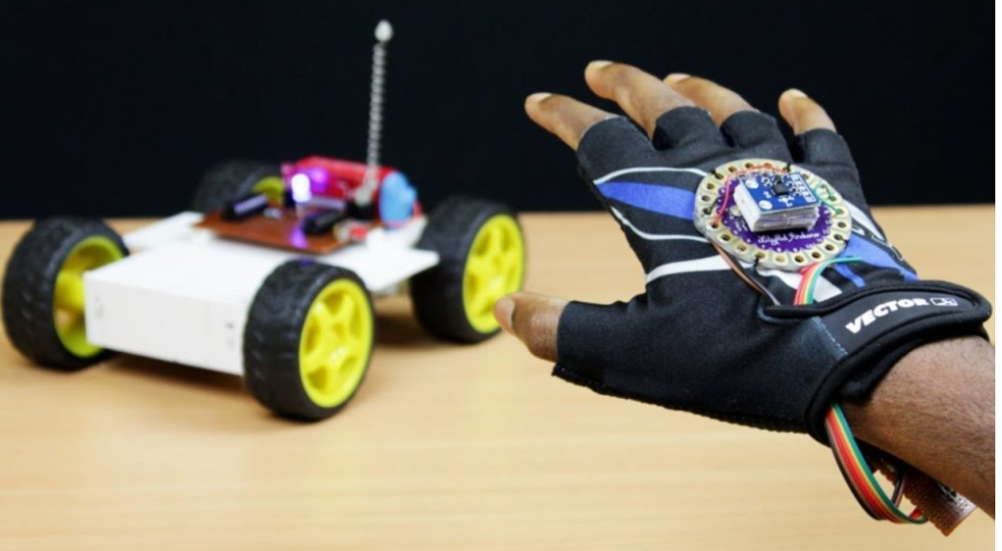
And more…

Slide 17
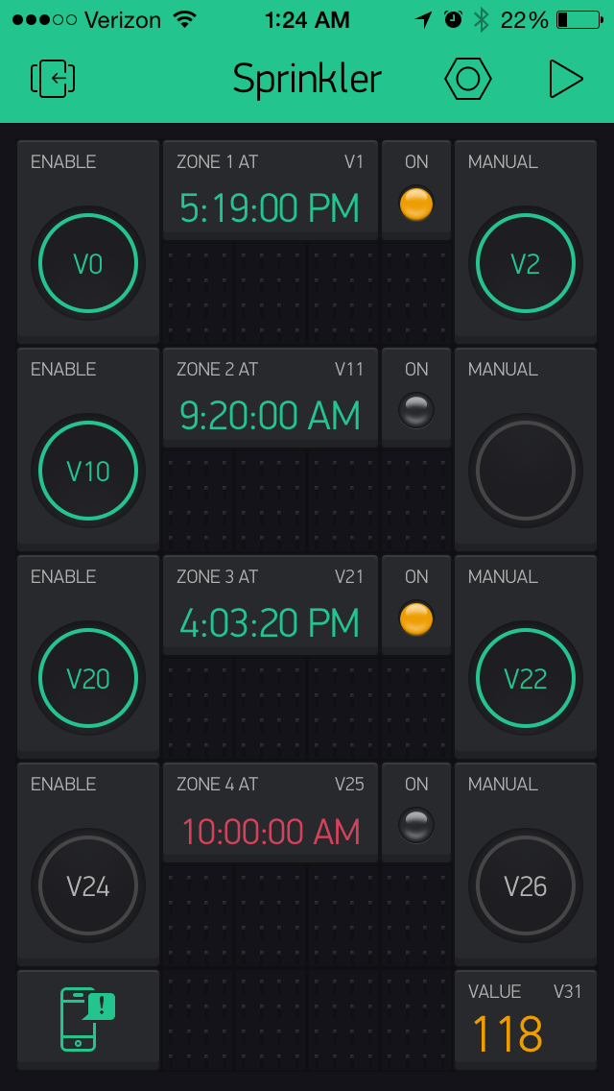
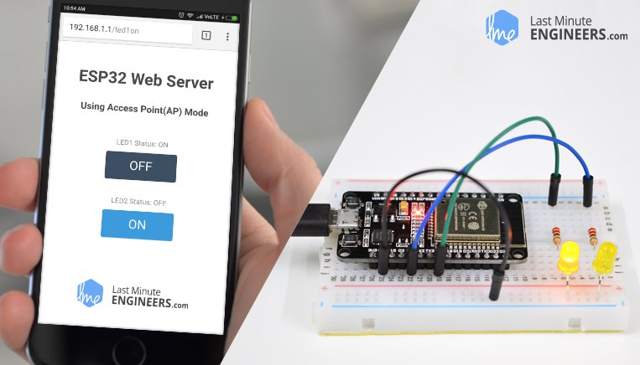
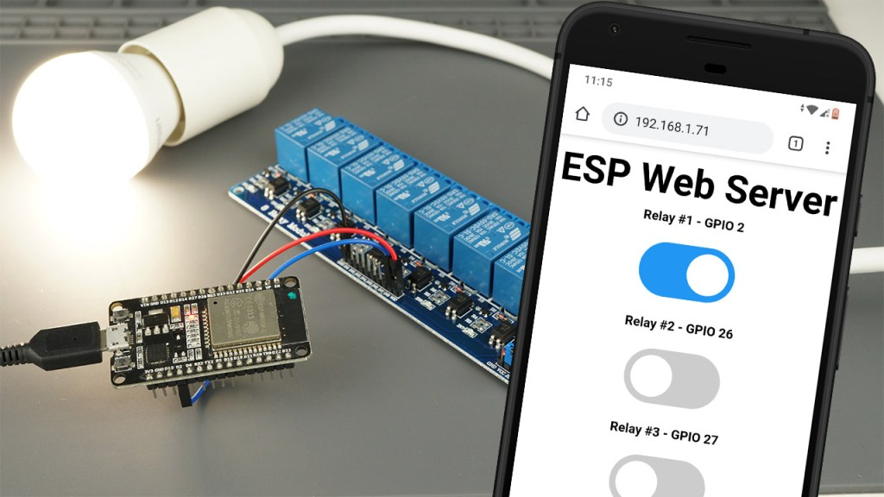
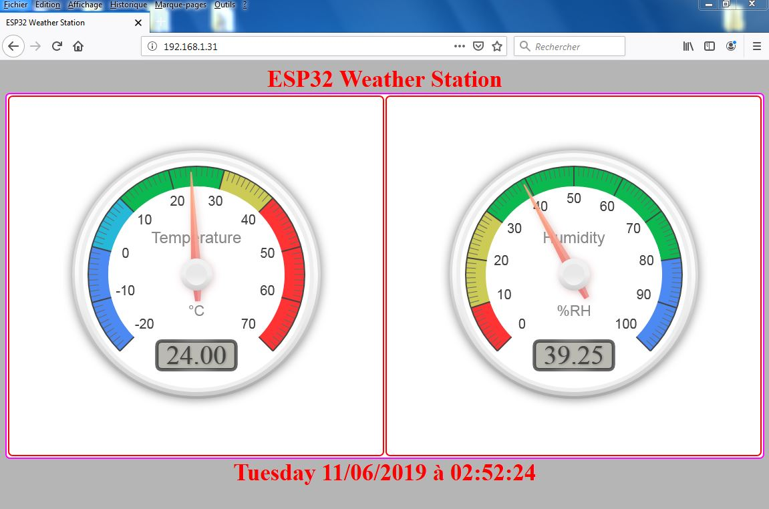
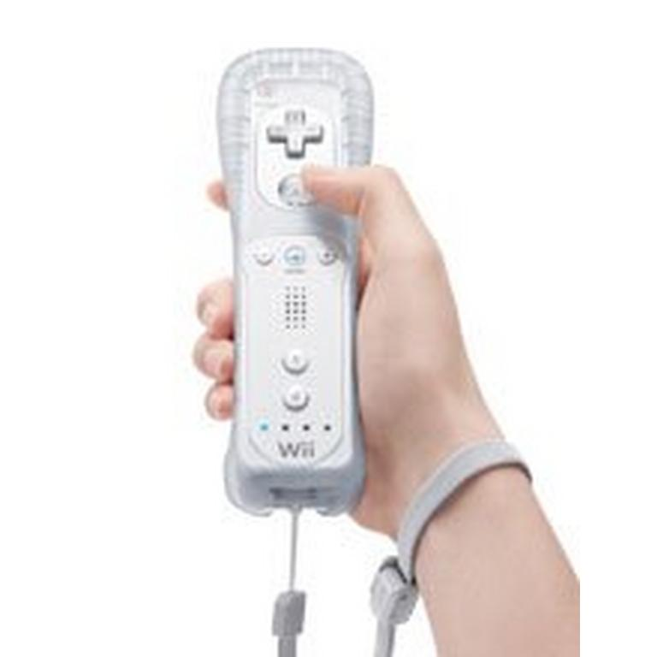
How can we control our devices …
Using our smartphone \ Tablet
Any device with a browser
WII mote (Via Bluetooth)
IR remotes
Build our own control device

Slide 18
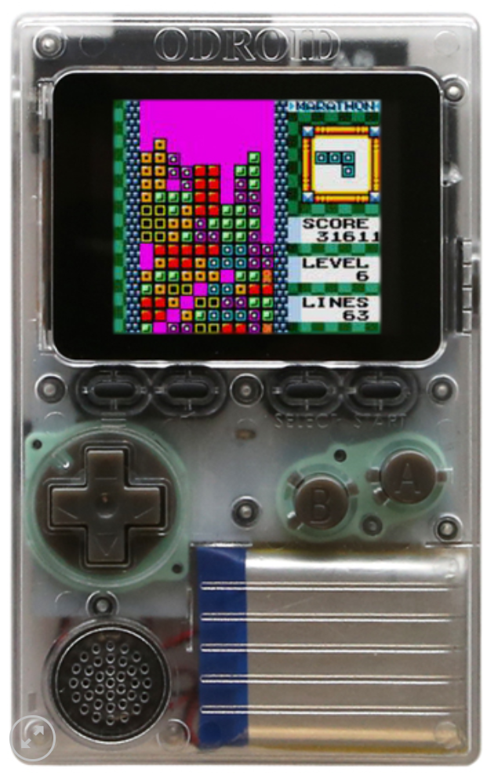
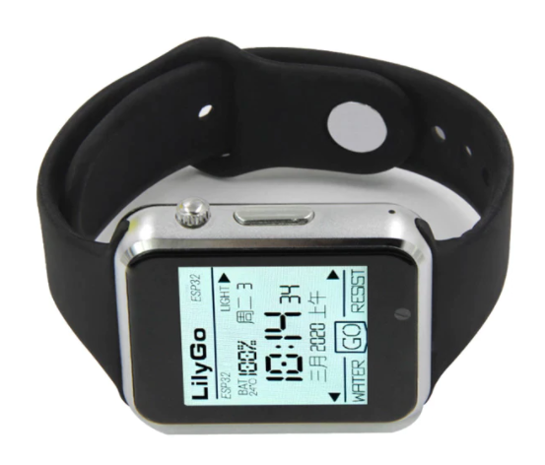
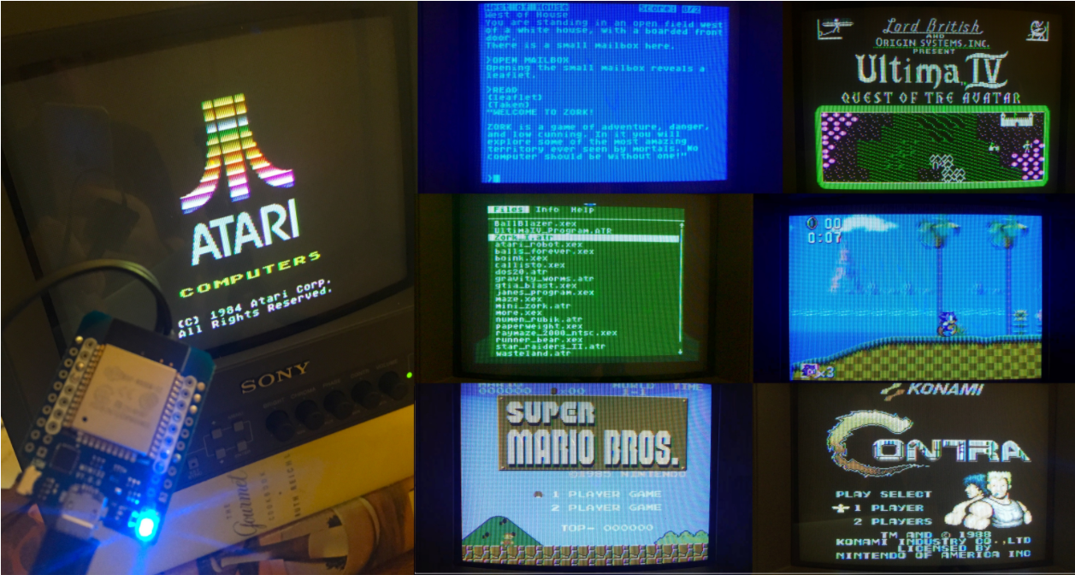

ESP32 cool projects…

Slide 19





More ESP32 cool projects…

Slide 20




Raspberry PI 4 projects

Slide 21






More of the R-PI4…
Zoom meeting station

Slide 22




Some of my own ☺

Slide 23







Slide 24
Is it of any use at work!?

